Slide 1


Who Wants to
Be a Millionaire?
Notes:
Lifeline icons on the question slides are hyperlinks which will take you to the lifeline screen. To return to the game, you may right click on the screen, choose Go, Previously Viewed. This should return you to the question slide. Alternatively, left click as usual to return to the game board, then click on the highest number that has been previously selected (in gold to indicate a followed hyperlink).
To utilize the 50:50 option, the moderator may tell the contestant which two options to disregard or, use Control-P to change the mouse arrow to a pen. Draw a line through two incorrect responses, then use Control-A to change the pen back into an arrow and continue with the game.
Clicking on the action button on the phone handset image of the Phone a Friend lifeline slide will hyperlink to the Ask Jeeves web site where the participant may ask for help.

Slide 2



1,000,000
500,000
250,000
125,000
64,000
32,000
16,000
8,000
4,000
2,000
1,000
500
300
200
100

Slide 3


Click to return to question, Cont-P to switch to the pen, cross out two incorrect answers, then Cont-A to switch back to pointer.

Slide 4

Click to return to the question and poll the class

Slide 5
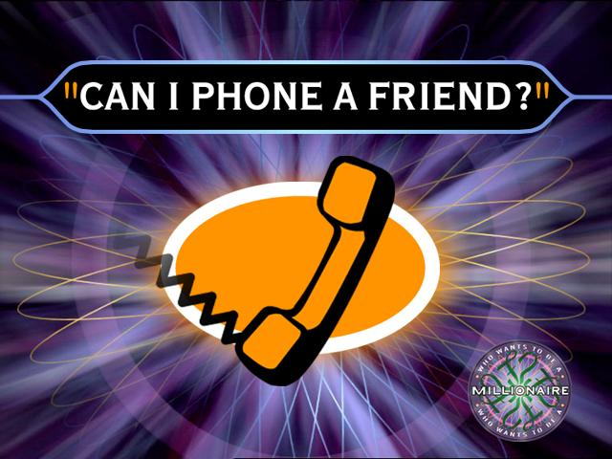
Click on link to Ask Jeeves, or click on this oval to return to question and ask a friend

Slide 6
Who plays the Terminator?
A. Arnold Schwarzenegger
B. Will Smith
C. Mike Myers
D. Bob Marley

Slide 7
A. Arnold Schwarzenegger
Back to Board

Slide 8
Who is the blondest movie star?
A. Jessica Simpson
B. Hannah Montana
C. Paris Hilton
D. Taylor Swift

Slide 9
C. Paris Hillton
Back to Board

Slide 10
Who’s comedy programme won him 3 emys?
A. Friends
B. Everybody loves Raymond
C. The Simpsons
D.Neighbours

Slide 11
B. Everybody loves raymond
Back to Board

Slide 12
Who discovered the theory of gravity?
A. Issac Newton
B. Shanaya
C. Albert Einstein
D. Steven Hawking

Slide 13
A. Issac Newton
Back to Board

Slide 14
What is the warriors of the world artist?
A. Slayer
B. Green day
C. Mettalica
D. Manowar

Slide 15
D. Manowar
Back to Board

Slide 16
Who is the strongest dark wizard from harry poter?
A. Professer Snape
B. Hagrid
C. Lord Voldermort
D. Bellatrix Lestrange

Slide 17
C. Lord Voldermort
Back to Board

Slide 18
Who is the richest famous person?
A. jonny depp
B. Will Smith
C. Mike Myers
D. Tiger woods

Slide 19
B. Will Smith 80 mil
Back to Board

Slide 20
What is the name of the prison in Harry Potter
A. Milkatraz
B. Alcatraz
C. Azkaban
D. Maskaban

Slide 21
C. Azkaban
Back to Board

Slide 22
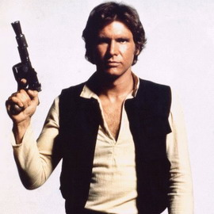
Who plays this character?
A. Mike Myers
B. Harrison Holden
C. Jesse Guillemot
D. Harrison Ford

Slide 23
D. Harrison Ford
Back to Board

Slide 24
What Character does Daniel Radcliffe play?
A. Ron Weasly
B. Harry Potter
C. Hermione Granger
D. Connor Winmill

Slide 25
B. Harry Potter
Back to Board

Slide 26
Who won Britain's got talent 2007?
A. Paul Pots
B. Susan Boyle
C. Simon Cowell
D. Paul Pan

Slide 27
A. Paul Pots
Back to Board

Slide 28
Maowar is a…
A. Movie
B. Band
C. Person
D. Place

Slide 29
B. Band
Back to Board

Slide 30
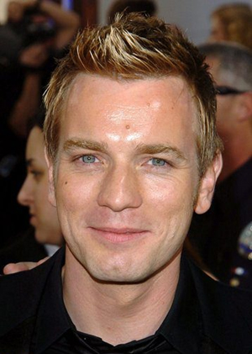
Who is this person?
A. Bart Simpson
B. Frankie Muniz
C. Ewan McGregor
D. Harrison Ford

Slide 31
C. Ewan McGregor
Back to Board

Slide 32
Who does the voice of Shrek?
A. jade nikora
B. jams o Brien
C. Heath ledger
D. mike Myers

Slide 33
D. Mike Myers
Back to Board

Slide 34
Who directed Star Wars & Indiana Jones?
a. George lucus
B. Peter Jackson
c. timothy blame
D. Steven Speilberg

Slide 35
A. George Lucus

Slide 36
Sorry, try again!

Slide 37
Thanks for playing!

